Slide 1
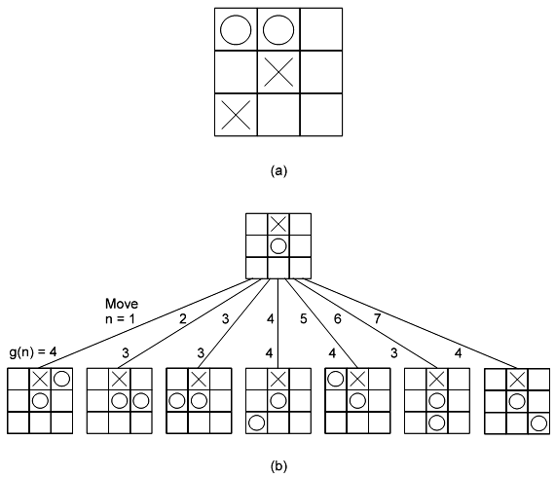
Computer Game – Tic Tac Toe
How To Program (the AI)?
KB - Kuliah 4 (Problem, Problem Spaces & Search)

Slide 2
Tic Tac Toe – Rule Base
Assume: X play first (odd turn)
Data Structures
- Board: 9 elemen vector
Store number 2 if blank,
3 indicating X,
5 indicating O.
- Turn: An integer
Indicating which move of the game right now. (1 first move, 9 last move)
1 | 2 | 3
4 | 5 | 6
7 | 8 | 9
Board:
2 | 2 | 2 | 2 | 2 | 2 | 2 | 2 | 2
1 | 2 | 3 | 4 | 5 | 6 | 7 | 8 | 9
KB - Kuliah 4 (Problem, Problem Spaces & Search)

Slide 3
Tic Tac Toe – Rule Base
The Algorithms
int Make2( ):
  Return 5 if center square is blank (Board[5] = 2), otherwise return any blank non-corner square (2, 4, 6, 8)
int Posswin(p): This function will enable the program to win or to block the opponent’s win.
  Return 0 if player p cannot win on his next move, otherwise return the number of the square that constitute a winning move.
  How to see the possible win?
    Checking each row, column and diagonal.
    Multiply the value of each square.
    If the product is 18 (3 * 3 * 2) then X can win.
    If the product is 50 (5 * 5 * 2) then O can win.
  If we find winning row / column / diagonal, search for blank square then return the number of that square.
Go(n):
  Make a move in square n.
  Board[n] = 3 if Turn is odd, or 5 if Turn is even.
  Increment Turn by 1.
KB - Kuliah 4 (Problem, Problem Spaces & Search)

Slide 4
Tic Tac Toe – Rule Base
The Rules (9 rules)
Uses odd-numbered rules if AI playing X, and even-numbered rules if O.
  Turn 1: Go(1)
  Turn 2: If Board[5] is blank Then Go(5) Else Go(1)
  Turn 3: If Board[9] is blank Then Go(9) Else Go(3)
  Turn 4: If Posswin(X) != 0 Then Go(Posswin(X)) Else Go(Make2()).
  Turn 5: If Posswin(X) != 0 Then Go(Posswin(X))
  Else If Posswin(O) != 0 Then Go(Posswin(O))
  Else If Board[7] is blank Then Go(7) Else Go(3)
  Turn 6: If Posswin(O) != 0 Then Go(Posswin(O))
  Else If Posswin(X) != 0 Then Go(Posswin(X)) Else Go(Make2())
  Turn 7: If Posswin(X) != 0 Then Go(Posswin(X))
  Else If Posswin(O) != 0 Then Go(Posswin(O))
  Else Go anywhere that is blank
  Turn 8: If Posswin(O) != 0 Then Go(Posswin(O))
  Else If Posswin(X) != 0 Then Go(Posswin(X))
  Else Go anywhere that is blank
  Turn 9: Same as Turn = 7
KB - Kuliah 4 (Problem, Problem Spaces & Search)

Slide 5
Tic Tac Toe – Rule Base
The Rules (9 rules)
Uses odd-numbered rules if AI playing X, and even-numbered rules if O.
  Turn 1: Go(1)
  Turn 2: If Board[5] is blank Then Go(5) Else Go(1)
  Turn 3: If Board[9] is blank Then Go(9) Else Go(3)
  Turn 4: If Posswin(X) != 0 Then Go(Posswin(X)) Else Go(Make2()).
  Turn 5: If Posswin(X) != 0 Then Go(Posswin(X))
  Else If Posswin(O) != 0 Then Go(Posswin(O))
  Else If Board[7] is blank Then Go(7) Else Go(3)
  Turn 6: If Posswin(O) != 0 Then Go(Posswin(O))
  Else If Posswin(X) != 0 Then Go(Posswin(X)) Else Go(Make2())
  Turn 7: If Posswin(X) != 0 Then Go(Posswin(X))
  Else If Posswin(O) != 0 Then Go(Posswin(O))
  Else Go anywhere that is blank
  Turn 8: If Posswin(O) != 0 Then Go(Posswin(O))
  Else If Posswin(X) != 0 Then Go(Posswin(X))
  Else Go anywhere that is blank
  Turn 9: Same as Turn = 7
KB - Kuliah 4 (Problem, Problem Spaces & Search)

Slide 6
Tic Tac Toe – Rule Base
The Algorithms
Make2( ):
  Return 5 if center square is blank (Board[5] = 2), otherwise return any blank non-corner square (2, 4, 6, 8)
Posswin(p): This function will enable the program to win or to block the opponent’s win.
  Return 0 if player p cannot win on his next move, otherwise return the number of the square that constitute a winning move.
  How to see the possible win?
    Checking each row, column and diagonal.
    Multiply the value of each square.
    If the product is 18 (3 * 3 * 2) then X can win.
    If the product is 50 (5 * 5 * 2) then O can win.
  If we find winning row / column / diagonal, search for blank square then return the number of that square.
Go(n):
  Make a move in square n.
  Board[n] = 3 if Turn is odd, or 5 if Turn is even.
  Increment Turn by 1.
KB - Kuliah 4 (Problem, Problem Spaces & Search)

Slide 7
Problems, Problem Spaces, Search
KB - Kuliah 4 (Problem, Problem Spaces & Search)

Slide 8
Problems, Problem Spaces, Search
Many problems in Artificial Intelligence can be represented as Search Spaces.
A Search Space is a representation of the set of possible choices in a given problem, one or more of which are the solution to the problem.
It will consist of:
  A problem space (or a State Space) -- a description of all possible states of the problem (explicit or implicit)
  A State in the space -- description of all problem variables or parameters
  A Set of Rules that allow us to move from one state to another
Many (maybe all?) problems can be described in this manner
KB - Kuliah 4 (Problem, Problem Spaces & Search)

Slide 9
A formal description of a problem must have
A defined State Space of all possible configurations
An Initial State
One or more Goal States
A Set of Rules / Operators which move the problem from one state to the next
KB - Kuliah 4 (Problem, Problem Spaces & Search)

Slide 10
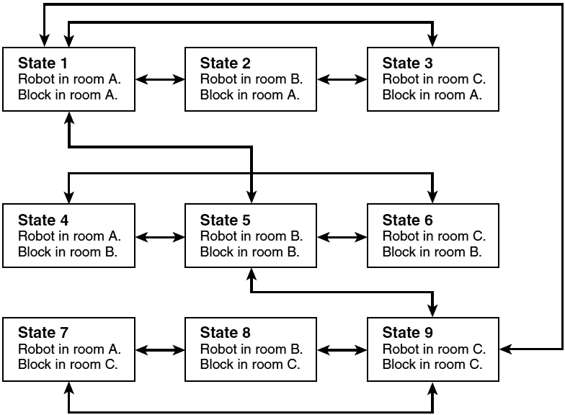
A Simple State-Space Example
Def: A robot that lives in an environment with three rooms (room A, room B, and room C) and with a block that he can move from room to room. Each state consists of a possible arrangement of the robot and the block.
KB - Kuliah 4 (Problem, Problem Spaces & Search)

Slide 11
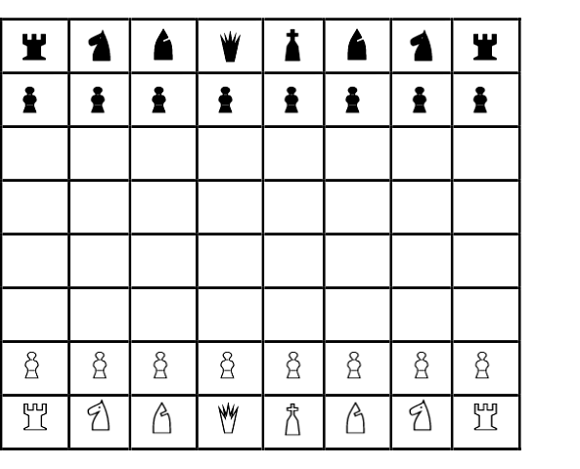
Computer Game - Chess
Apa yang perlu didefinisikan agar komputer dapat bermain catur ?
Papan Catur didefinisikan sebagai 8 x 8 array (atau 10 x 10, agar kuda tidak melompat keluar papan ?)
Posisi Awal
Langkah Legal untuk setiap bidak catur, termasuk cara memakan bidak lawan.
Posisi yang mengancam raja
Posisi Kemenangan dan tiga langkah (state) menuju Draw
KB - Kuliah 4 (Problem, Problem Spaces & Search)

Slide 12
Computer Game – Tic Tac Toe
Bagaimana cara memprogram ?
Pattern Matched:
(perlu berapa pattern ?... ±10¹²⁰ macam)
  - Bisakah seseorang mendefiniskan seluruh posisi yang mungkin ada ?
  - Adakah program yang bisa melakukan matching pattern - pattern tersebut dalam waktu cepat ?
Rule – rule spesifik untuk setiap ‘Turn’ ?
  - Berapa banyak kombinasi langkah yang ada pada setiap ‘Turn’ ?
  - Ada berapa ‘Turn’ ?
State Space Search:
  - Mendefinisikan Rule untuk ‘Legal Move’ se-umum mungkin.
  - Mencari Legal Move yang dapat diaplikasikan pada setiap keadaan (States) untuk setiap ‘Turn’ dan berusaha untuk mencapai salah satu Final States yang ada (MiniMax Algorithm)
KB - Kuliah 4 (Problem, Problem Spaces & Search)

Slide 13

Water Jug Problem
Ada dua buah Jug (Ember), dengan kapasitas maksimum, 1 buah jug sebesar 4 liter, yang lain 3 liter.
Tidak ada tanda pada kedua Jug tersebut.
Ada sebuah pompa yang dapat mengisi kedua Jug tersebut sampai penuh.
Pertanyaan:
Bagaimana cara mendapatkan tepat 2 liter air pada Jug yang berukuran maks. 4 liter ?
4 lt
3 lt
KB - Kuliah 4 (Problem, Problem Spaces & Search)

Slide 14
Water Jug Problem
Penyelesaian:
Anggap 2 buah Jug sebagai dua buah variable x dan y, dimana x hanya dapat diisi bilangan 0, 1, 2, 3 dan 4, dan y dengan bilangan 0, 1, 2 dan 3.
Start State adalah (x, y) → (0,0)
Goal State adalah (x, y) → (2,n), n adalah sembarang bilangan, artinya: Isi jug 3 liter pada saat akhir tidak didefinisikan.
KB - Kuliah 4 (Problem, Problem Spaces & Search)

Slide 15
Water Jug Problem
Rule - rule agar AI dapat mencari solusi: (Production Rules)
IF THEN Keterangan:
If x < 4 (x, y) → (4, y) Isi Jug 4 liter
If y < 3 (x, y) → (x, 3) Isi Jug 3 liter
If x > 0 (x, y) → (0, y) Kosongkan Jug 4 liter
If y > 0 (x, y) → (x, 0) Kosongkan Jug 3 liter
If x + y >= 4 AND y > 0 (x, y) → (4, y – (4 – x)) Tuangkan air dalam Jug 3 liter kedalam Jug 4 liter sampai penuh
If x + y >= 3 AND x > 0 (x, y) → (x – (3 – y), 3) Tuangkan air dalam Jug 4 liter kedalam Jug 3 liter sampai penuh
If x + y <= 4 AND y > 0 (x, y) → (x + y, 0) Tuangkan semua air pada Jug 3 liter kedalam Jug 4 liter
If x + y <= 3 AND x > 0 (x, y) → (0, x + y) Tuangkan semua air pada Jug 4 liter kedalam Jug 3 liter
KB - Kuliah 4 (Problem, Problem Spaces & Search)

Slide 16
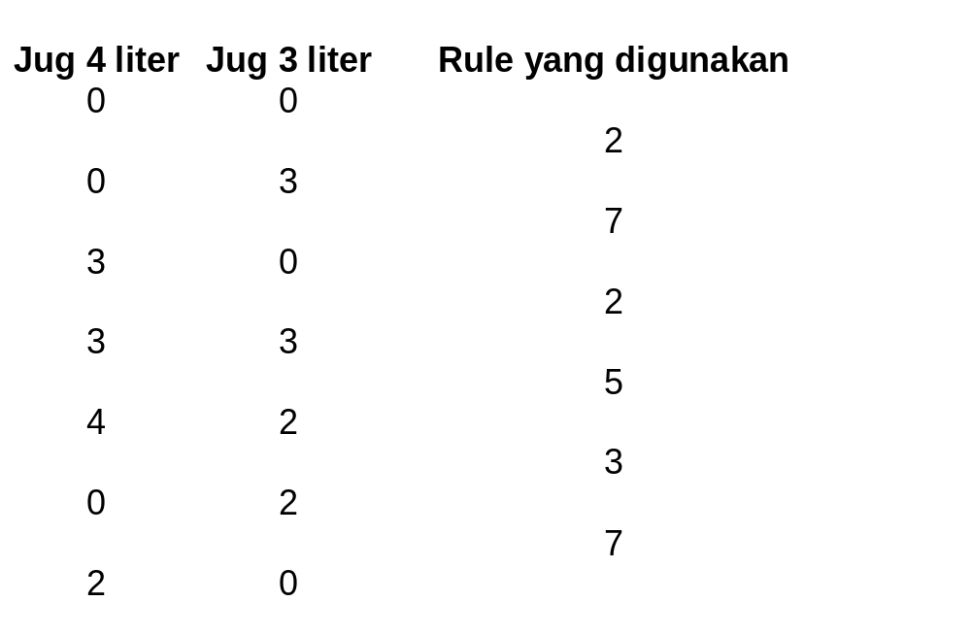
Water Jug Problem
Salah satu Solusi yang mungkin ada:
KB - Kuliah 4 (Problem, Problem Spaces & Search)

Slide 17
Production Rules:
If - Then statements:
  Given the current state, what will happen when this rule is applied?
  What state will the rule move us to?
Factors to consider:
  Is time a consideration?
  Are there unstated assumptions?
  How general or specific should the rules be?
  How much of the solution should be precomputed?
Example:
Chess – each piece has rules governing how the piece is moved
KB - Kuliah 4 (Problem, Problem Spaces & Search)

Slide 18
Production Systems
A set of rules that determine the applicability of each operator
  Working memory (storing current values of all variables and any knowledge that is needed)
  Control strategy for choosing a rule
    A search control strategy must have the following characteristics:
      cause ‘motion’ in the system
      be systematic in exploring search space
  Conflict resolution (in case multiple rules are chosen)
  A means of applying the rule
KB - Kuliah 4 (Problem, Problem Spaces & Search)

Slide 19
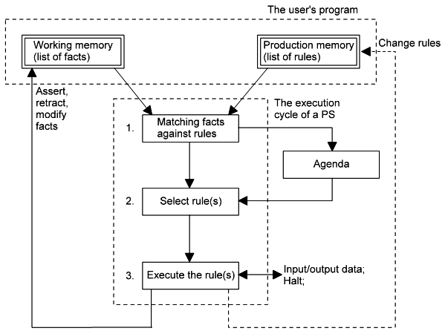
Production System Cycle
KB - Kuliah 4 (Problem, Problem Spaces & Search)

Slide 20
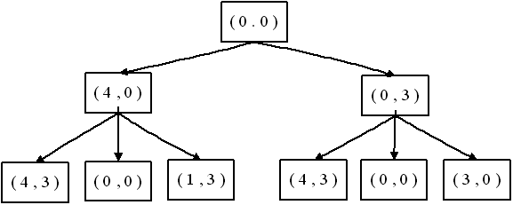
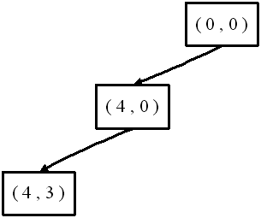
Control Strategy
Brute Force Search
  Breadth – First Search
  Depth – First Search
KB - Kuliah 4 (Problem, Problem Spaces & Search)

Slide 21
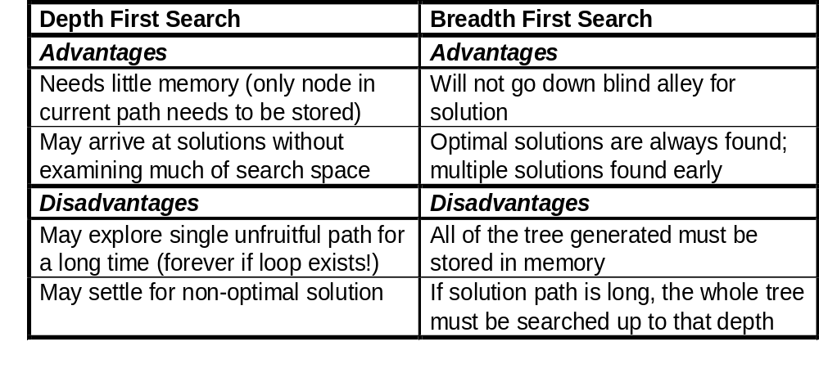
Control Strategy
KB - Kuliah 4 (Problem, Problem Spaces & Search)

Slide 22
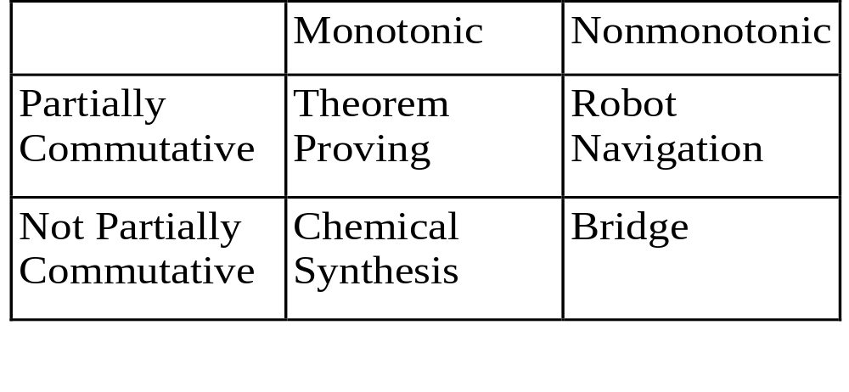
Four Categories of Production System
KB - Kuliah 4 (Problem, Problem Spaces & Search)

Slide 23
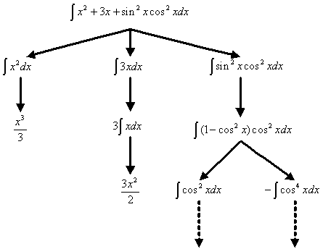
Problem Characteristics
1. Is the problem decomposable?
KB - Kuliah 4 (Problem, Problem Spaces & Search)

Slide 24
Problem Characteristics
2. Can solution steps be undone or ignored?
    Ignorable : Theorem Proving
    Recoverable : 8 Puzzle Game
    Irrecoverable : Chess, Tic Tac Toe
3. Is the problem’s universe predictable?
    Certain Outcome : 8 Puzzle, Tic Tac Toe (3x3)
    Uncertain Outcome : Chess, Card Game
KB - Kuliah 4 (Problem, Problem Spaces & Search)

Slide 25
Problem Characteristics
4. Is a good solution absolute or relative?
Fact:
  Marcus was a man
  Marcus was a Pompeian
  Marcus was born in 40 A.D
  All men are mortal
  All Pompeian died when the volcano erupted in 79 A.D
  No mortal lives longer than 150 years
  It is now 2014 A.D
Question: Is Marcus alive??
KB - Kuliah 4 (Problem, Problem Spaces & Search)

Slide 26
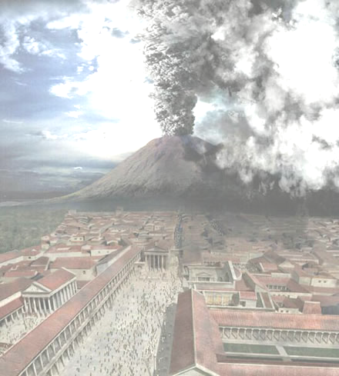
Problem Characteristics
Two way to prove that Marcus is dead
First:
  Marcus was a man
  All men are mortal
  Marcus is mortal
  Marcus was born in 40 A.D
  It is now 2014 A.D
  Marcus age is 1974 years
  No mortal lives longer than 150 years
  Marcus is dead
  Second:
  It is now 2014 A.D
  All Pompeian died when the volcano erupted in 79 A.D
  All Pompeian are dead now
  Marcus was a Pompeian
  Marcus is dead
KB - Kuliah 4 (Problem, Problem Spaces & Search)

Slide 27
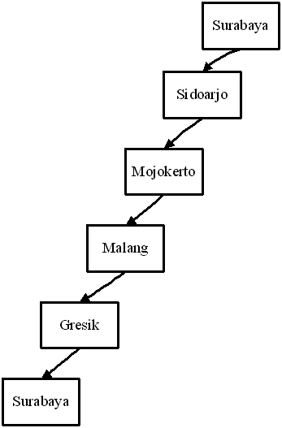
Problem Characteristics
5. Is the desired solution a state or a path?
  State Solution: Theorem Proving, Water Jug, Chess
  Path Solution: Traveling Salesman Problem
KB - Kuliah 4 (Problem, Problem Spaces & Search)

Slide 28
Problem Characteristics
6. Is a large amount of knowledge absolutely required (to find a solution)?
  No : Chess, Tic Tac Toe, Water Jug
  Yes : Expert System
7. Is problem solving interactive?
KB - Kuliah 4 (Problem, Problem Spaces & Search)

Slide 29



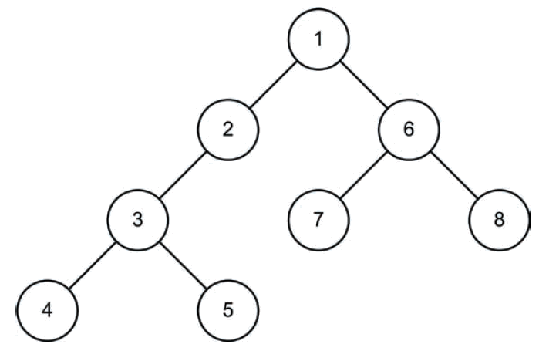
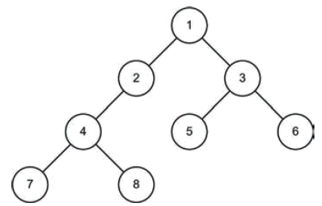
Brute Force
Search
Depth – First Search
Breadth – First Search
KB - Kuliah 4 (Problem, Problem Spaces & Search)

Slide 30

Brute Force Search
Tidak mengaplikasikan teknik Heuristic apapun dalam mencari pemecahan sebuah masalah
  Teknik ini disebut blind forms of search
  Biasanya sangat tidak efisien
Digunakan bila sama sekali tidak ada knowledge yang bisa didapat dari sebuah problem
Contoh:
  Traveling Salesman Problem
  8 Queens Problem
  Knight’s Tour Problem
KB - Kuliah 4 (Problem, Problem Spaces & Search)

Slide 31
Depth First Search
p = root()
df(p) =
if not empty(p) then
if good(p) then
success(p)
else
for q ∈ succ(p) do df(q) od
fi
fi
Definitions:
succ(p ) ⇒ successors of the node p.
empty(p) ⇒ true when p is empty.
(More detail Algo → Artificial Intelligence Illuminated.pdf)
KB - Kuliah 4 (Problem, Problem Spaces & Search)

Slide 32
Depth First Search Example
Tree of Problem Space
A
B
C
D
E
F
G
H
I
Solution
KB - Kuliah 4 (Problem, Problem Spaces & Search)

Slide 33
Depth First Search
p = root()
df(p) =
if not empty(p) then
if good(p) then
success(p)
else
for q ∈ succ(p) do df(q) od
fi
fi
Definitions:
succ(p ) ⇒ successors of the node p.
empty(p) ⇒ true when p is empty.
(More detail Algo → Artificial Intelligence Illuminated.pdf)
KB - Kuliah 4 (Problem, Problem Spaces & Search)

Slide 34
Breadth First Search
p = root()
bf(p) =
while not empty(p) do
while not empty(p) do
if good(p) then success(p) fi;
p=next(p)
od;
p=down(p)
od;
failure()
Definitions:
next(p) ⇒ the node next to p on the same layer as p is in the tree.
down(p) ⇒ the first node on the level next to the layer of p in the tree.
empty(p) ⇒ true, if the node p is empty (absent) in the tree.
(More detail Algo → Artificial Intelligence Illuminated.pdf)
KB - Kuliah 4 (Problem, Problem Spaces & Search)

Slide 35
Breadth First Search Example
Tree of Problem Space
A
B
C
D
E
F
G
H
I
Solution
KB - Kuliah 4 (Problem, Problem Spaces & Search)

Slide 36
Breadth First Search
p = root()
bf(p) =
while not empty(p) do
while not empty(p) do
if good(p) then success(p) fi;
p=next(p)
od;
p=down(p)
od;
failure()
Definitions:
next(p) ⇒ the node next to p on the same layer as p is in the tree.
down(p) ⇒ the first node on the level next to the layer of p in the tree.
empty(p) ⇒ true, if the node p is empty (absent) in the tree.
(More detail Algo → Artificial Intelligence Illuminated.pdf)
KB - Kuliah 4 (Problem, Problem Spaces & Search)

Slide 37
Thanks
KB - Kuliah 4 (Problem, Problem Spaces & Search)

